Slide 1
Straightforward algorithm
PERMISSIBLE_RATIO = 0.5 PERMISSIBLE_DELTA = 30
def deviation(pixela, pixelb, delta=10): for i in range(3): if abs(pixela[i] - pixelb[i]) > delta: return False return True

Slide 2
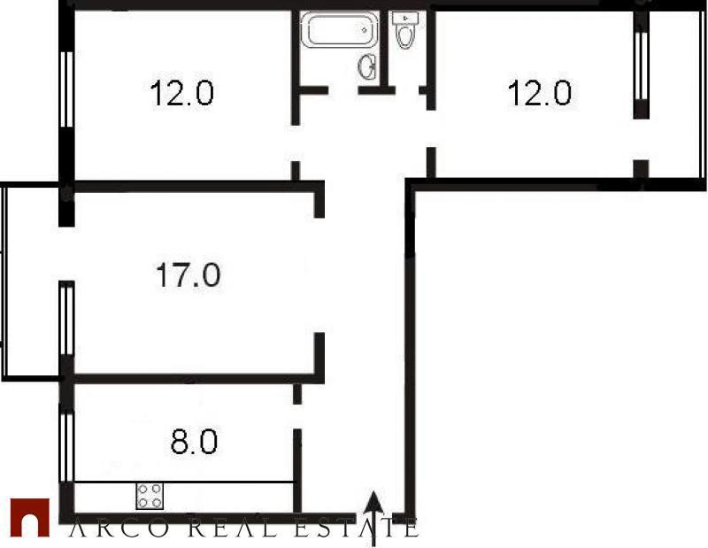
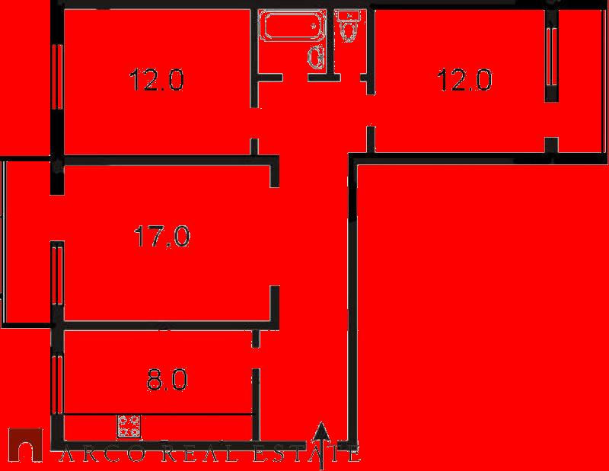
#id3775664: 86% - white

Slide 3
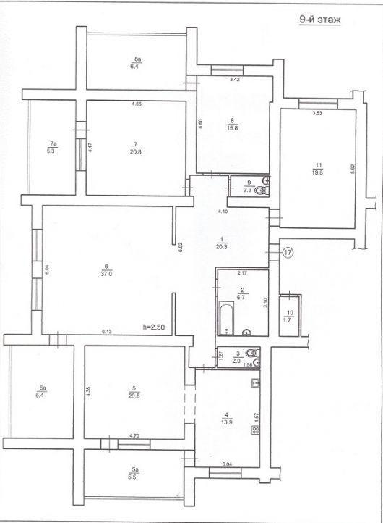
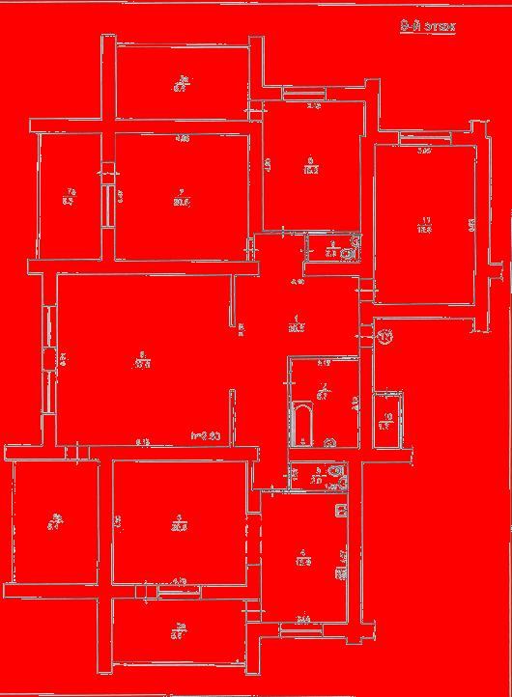
#id24228980: 92% - white

Slide 4
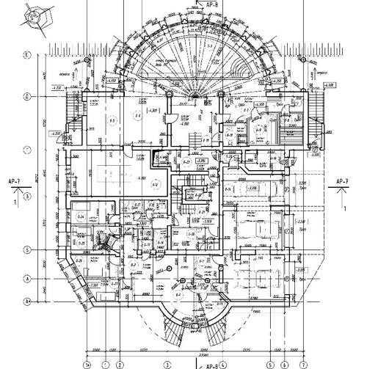
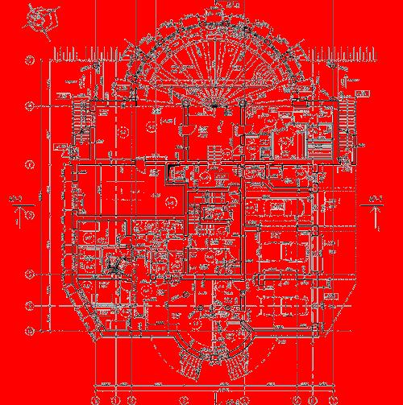
#id53225173: 77% - white

Slide 5


#id51136501: 54% - white

Slide 6
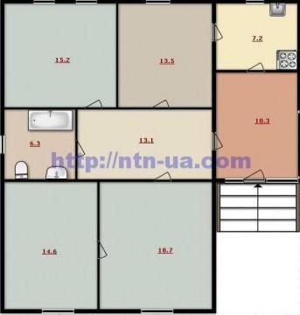
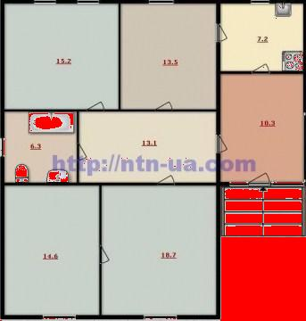
#id40906374: 10% - white

Slide 7
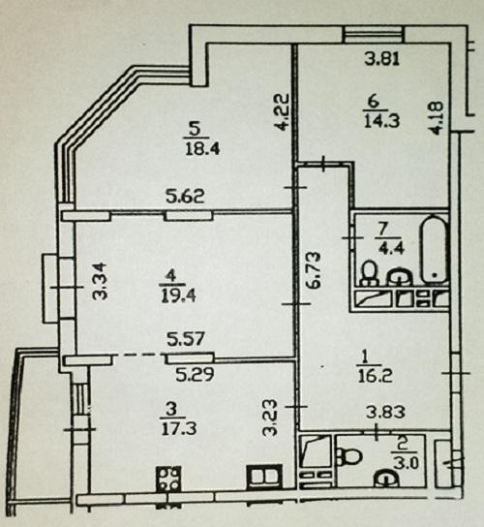
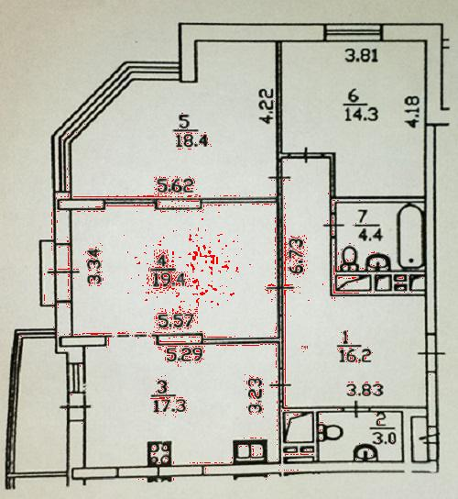
#id101404177: 1% - white

Slide 8
BFS algorithm
PERMISSIBLE_RATIO_AREA = 0.03 PERMISSIBLE_RATIO_SUMMARY = 0.4 PERMISSIBLE_DELTA_GREY = 10 PERMISSIBLE_DELTA = 5
def deviation_grey(pixel, delta=15, minimum=180): return abs(pixel[0] - pixel[1]) < delta \ and abs(pixel[1] - pixel[2]) < delta \ and abs(pixel[2] - pixel[0]) < delta \ and sum(pixel) > 3 * minimum

Slide 9
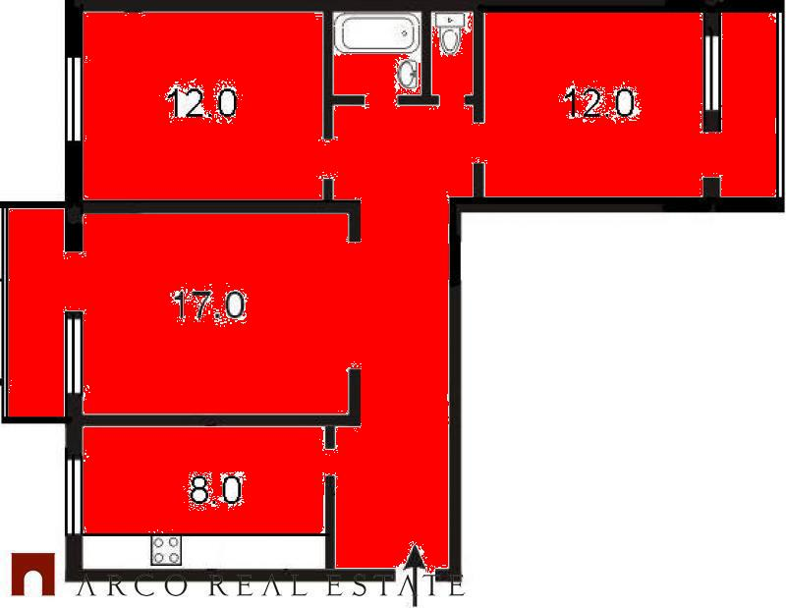
#id3775664: > 40% - OK

Slide 10
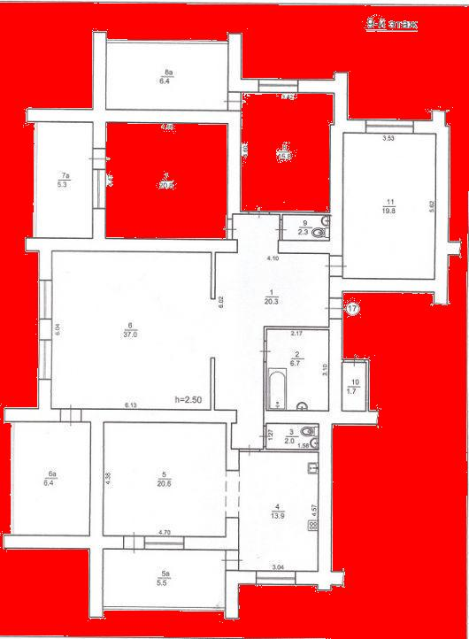
#id24228980: > 40% - OK

Slide 11
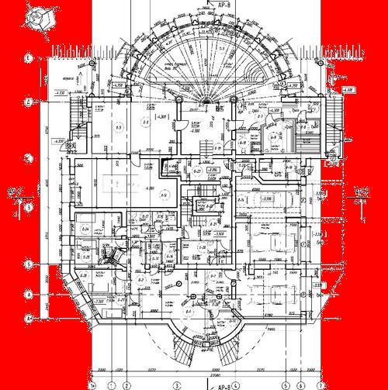
#id53225173: only 30% - FAIL

Slide 12

#id51136501: 36% - OK

Slide 13
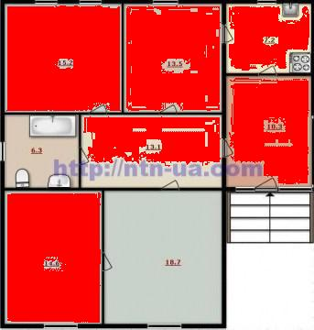
#id40906374: > 40% - OK

Slide 14
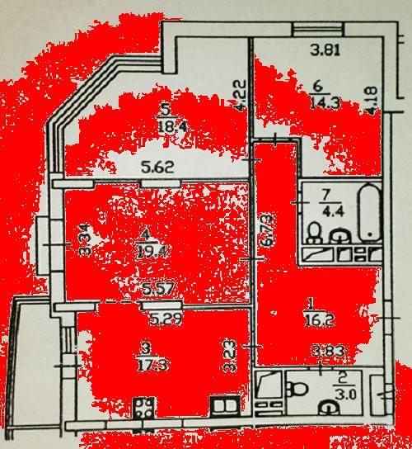
#id101404177: > 40% - OK

Slide 15
BFS FAILS

Slide 16
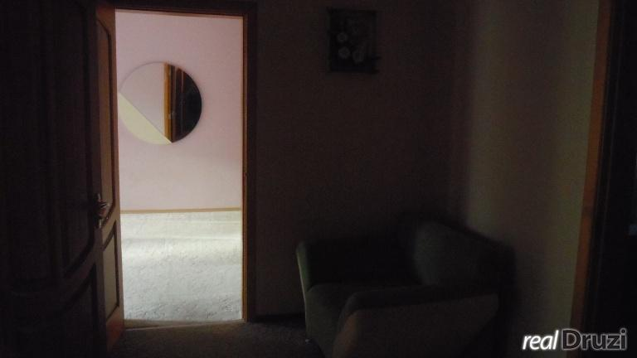
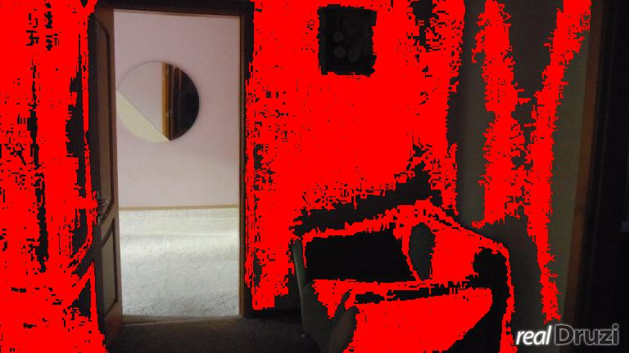
#id39240160

Slide 17
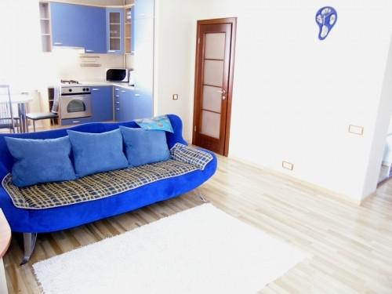
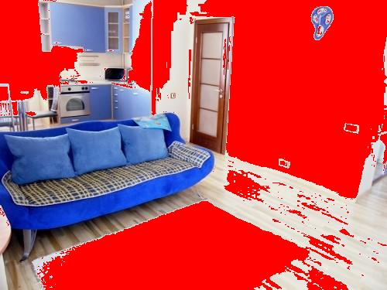
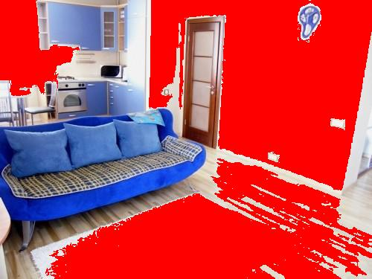
#id39255814, straightforward – 46% white - FAIL

Slide 18
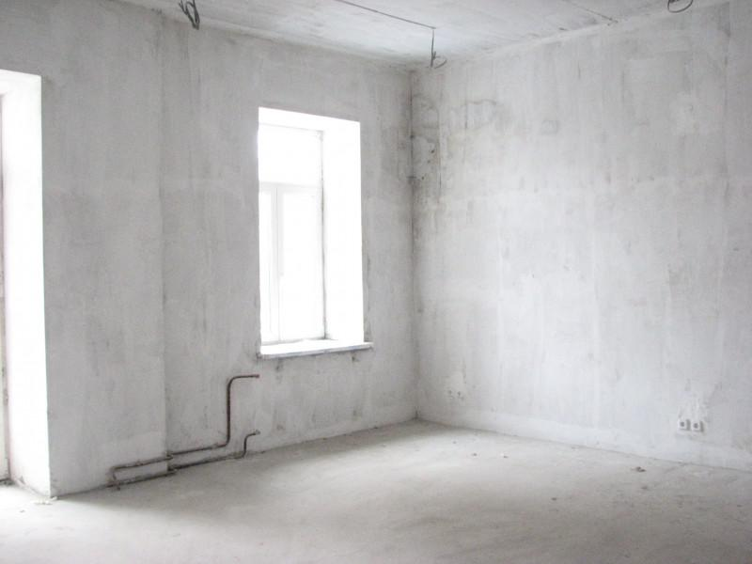
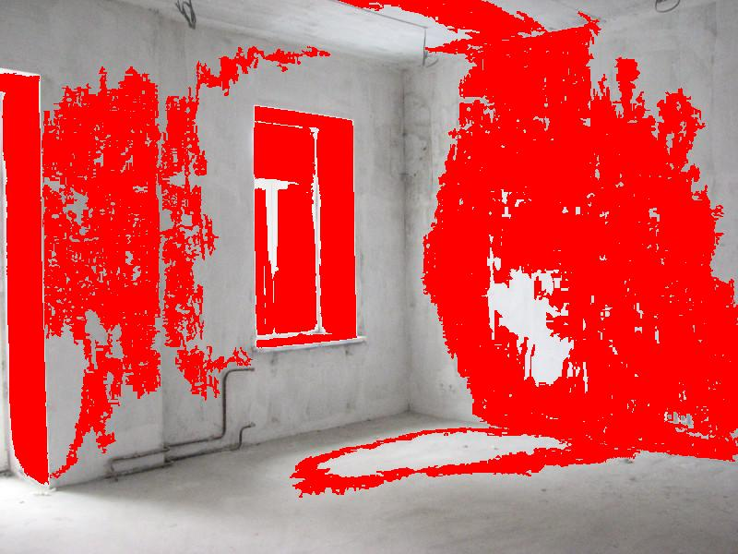
#id40856633

Slide 19
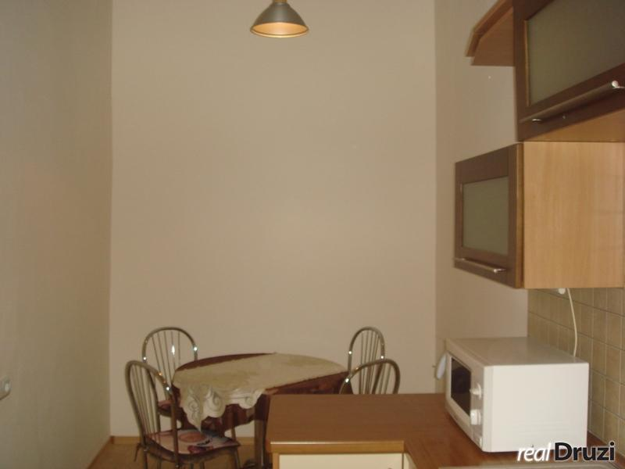
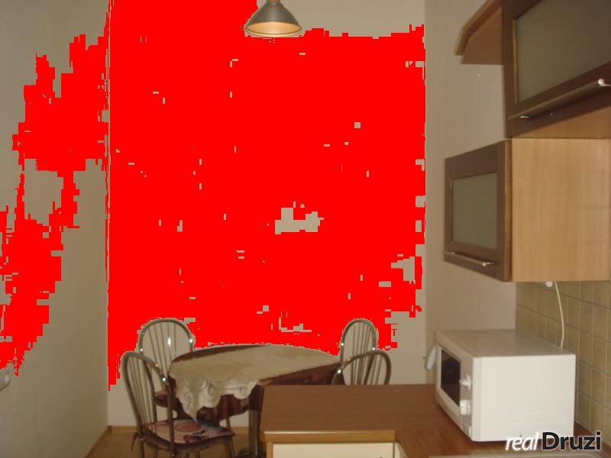
#id42043445

Slide 20

Results
Total | 999043 | 100%
not layout | 936344 | 93.72%
both | 45548 | 4.55% | <1%
straightforward | 1186 | 0.11% | <3%
bfs | 15965 | 1.59% | <40%

